Slide 1

Drone-based surveillance system for the vessels plying in port areas and encroachments
Ministry of Ports, Shipping and Waterways
PS Code : SIH1310
Problem Statement Title: Drone-based surveillance system for the vessels plying in port areas and encroachments
Team Name: E-Block
Team Leader Name: Harshvardhan Singh Thakur
Institute Code (AISHE): C-16641
Institute Name: Government Engineering College Raipur
Theme Name: Hardware Project
1

Slide 2
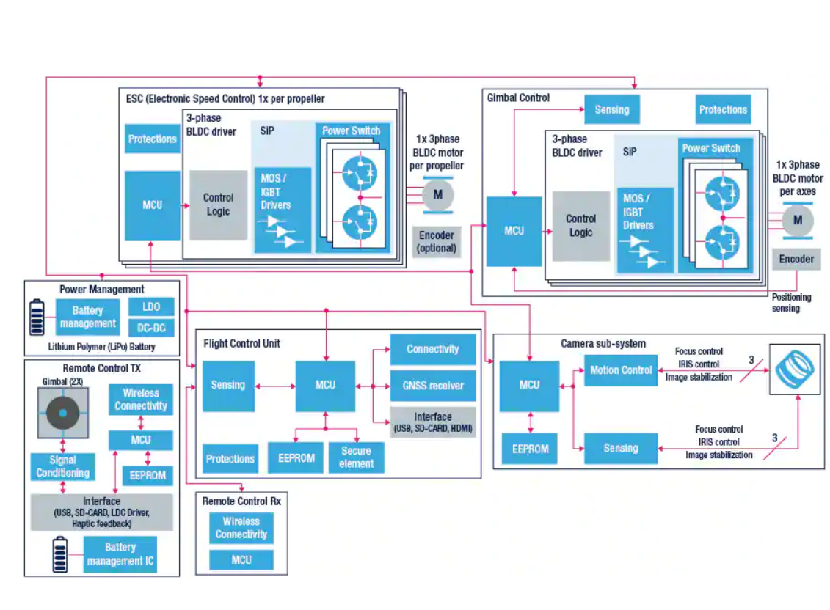








Idea/Approach Details
Idea/Solution:
We have devised a three-split monitoring system tracking harbor crafts, detecting encroachments, and a Management Information System(MIS).
The Tracking system harnesses Image processing and Cross verification with real time data ( MMSI ) tech for real-time monitoring, a centralized dashboard, and automated alerts.
Our Encroachment detection deploys drones, machine learning for real time alerts and reporting.
Automation in Surveillance, by using the Mission planner we can automate the surveillance on predetermined path.
The MIS maintains violator records. The Cochin Port Monitoring System promises heightened efficiency and security. (idea point)
Technology Stack Used :

Slide 3
Idea/Approach Details
Use Cases
Dependencies/ Show Stoppers
Vessel Monitoring : Identify vessels that are not authorized to be in the port area.
Encroachment Detection : Detecting and flagging encroachments on port facilities.
Security and Intrusion Detection: Providing real-time alerts for potential
Traffic Management : Coordinating vessel movements to ensure safe navigation.
Emergency Response : Supporting search and rescue operations in case of accidents or emergencies.
Logging and Reporting : Generating reports on vessel
Integration with Port Systems: Controlling access gates , to enhance overall port operations.
Remote Inspection : Conducting Remote inspection of vessels to access their condition, cargo and safety compliances.
Regulatory and legal compliance : Maintaining responsible drone operations.
Limited Flight Time : Constraints of a drone’s limited battery.
Signal Interference : Signal controls and disruptions in communication, that can affect drone’s performance.
Adverse weather conditions : Dealing with strong winds, rain, or fog etc.
Hardware failures (mechanical / electrical) : Addressing failure modes in drone’s components.
Navigation and collision avoidance : Collision avoidance systems to ensure safe and controlled drone movements.
Communication range limitations : Communication range between the drone and the ground control station
Cost and budget constraints : Managing budget limitations and ensuring cost-effective drone operations.

Slide 4
Team Member Details
Team Leader Name: Harshvardhan Singh Thakur
Branch: Btech Stream : EEE Year : IV
Team Member 1 Name: Shashwat Dhurandhar
Branch : Btech Stream : EEE Year : IV
Team Member 2 Name: Jhavika Uikey
Branch : Btech Stream : EEE Year : IV
Team Member 3 Name: Tanshi Shah
Branch : Btech Stream : EEE Year : III
Team Member 4 Name: Gunjan Shah
Branch : Btech Stream : EEE Year : I
Team Member 5 Name: Uttam Kumar Sahu
Branch : Btech Stream : Mechanical Year : III
Team Mentor 1 Name: Hitesh Chandrakar
Category (Academic/Industry): Microinverter Engineering Expertise (AI/ML/Blockchain etc) : Hardware Engineering Domain Experience (in years): 2

Slide 5
Important Pointers
Please ensure below pointers are met while
Kindly keep the maximum slides limit to 4 pages
All the topics should be utilized for description of your idea
Try to avoid paragraphs and post your idea in points
Keep your explanation precisely and easy to understand
Idea should be unique and novel. If it has a business potential more weightage will be given.
Apart from this PPT abstract of your idea will be asked separately while submitting
You need to save the file in PDF and upload the same on portal. No PPT, Word Doc or any other format will be supported
You can delete this slide (Important Pointers) when you upload the details of your idea on SIH portal.

